Slide 1





Noida Institute of Engineering and Technology, Greater Noida
(An Autonomous Institute)
Arithmetic & Logic Unit
Unit: 1 & 2
Subject Name
Computer Organization and Architecture(ACSE-0305)
AMIT YADAV
Assistant Professor
Department: ECE
Course Details
(B Tech 3rd Sem)
AMIT YADAV COA Unit 2

Slide 2
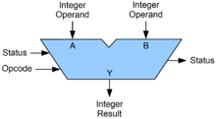
Arithmetic Logic Unit (ALU)
Arithmetic Logic Unit (ALU)
An arithmetic logic unit (ALU) is a digital circuit used perform arithmetic and logic operations.
It represents the fundamental building block of the central processing unit (CPU) of a computer. Modern CPUs contain very powerful and complex ALUs.
In addition to ALUs, modern CPUs contain a control unit (CU)
The inputs to an ALU are the data to be operated on, called operands, and a code indicating the operation to be performed.
A symbolic representation of an ALU and its input and output signals
AMIT YADAV COA Unit 2

Slide 3
Stack Organization
Stack Organization
A stack can be organized as a collection of a finite number of memory words or registers.
SP value always point at the top item in the stack.
The two operations of stacks are the insertion (push), and deletion (pop) of items.
The stack-organized CPU ,Computers with stack organization would have PUSH and POP instructions which require an address field. Thus the instruction
PUSH X
POP
AMIT YADAV ACSBS 0303 COA Unit I

Slide 4
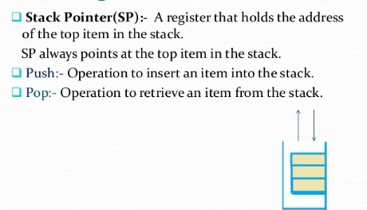
Stack Organization
AMIT YADAV ACSBS 0303 COA Unit I

Slide 5
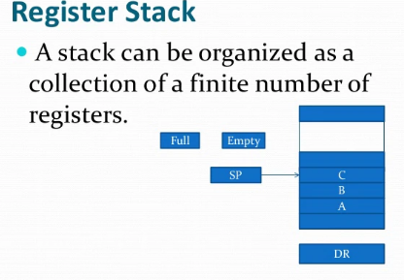
Stack Organization
AMIT YADAV ACSBS 0303 COA Unit I

Slide 6
Stack Organization
In register stack
The push operation is implemented with the following sequence of micro operations:
SP SP+1 Increment stack pointer
M[SP] DR Write item on top of the stack
If (SP=0) then (FULL 1) Check if stack is full
(when 63 is incremented by 1, the result is 0.)
EMPTY 0 Mark the stack not empty
`
AMIT YADAV ACSBS 0303 COA Unit I

Slide 7
Stack Organization
In register stack
The pop operation consists the following sequence of microoperations:
DR M[SP] Read item from top of the stack
SP SP-1 Decrement stack pointer
If (SP=0) then (EMPTY 1 ) Check if stack is empty
FULL 0 Mark the stack not full
A stack can exist as a stand-alone unit or can be implemented in a RAM attached to a CPU.
AMIT YADAV ACSBS 0303 COA Unit I

Slide 8
Reverse Polish Notation
Reverse Polish Notation
A stack organization is very effective for evaluating arithmetic expressions.
The reverse Polish notation is in a form suitable for stack manipulation, where the infix expression A*B+C*D can be written in Reverse Polish Notation (RPN or postfix notation) as: AB*CD*+
Example: Stack operation to evaluate 3*4+5*6
=> 34*56*+ (in in reverse Polish notation )
6
4
5
5
30
3
3
12
12
12
12
42
3
4
*
5
6
*
+
AMIT YADAV ACSBS 0303 COA Unit I

Slide 9
(i) (A*B)+(C*D)+(E*F)
Prefix (*AB)+(*CD)+(*EF)= (+*AB*CD)+(*EF)=++*AB*CD*EF
Postfix (AB*)+(CD*)+(EF*)=(AB*CD*+EF*+)
(ii) (A*B)+A*((B*D)+(C*E))
(*AB)+A*((*BD)+(*CE))
(*AB)+A*(+*BD*CE)
(*AB)+(*A+*BD*CE)
+*AB*A+*BD*CE
(iii) A*[B+(C*D)+E]/F*(G+H)
A*[B+(CD*)+E]/F*(GH+)
A*[(BCD*+)+E]/(FGH+*)
(ABCD*+E+*)/ (FGH+*)
ABCD*+E+*FGH+*/
A*B+(C*D)+E/F*(G+H)
AMIT YADAV ACSBS 0303 COA Unit I

Slide 10
Instruction Formats
Instruction Formats
The bits of the instruction are divided into groups called fields.
The most common fields founded in the instruction formats are:
1. An operation code field
2. An address field
3. A mode field
Data executed by instructions (operands) are stored either in memory or in processor registers.
Operands residing in memory are specified by their memory address.
Operands residing in registers are specified with a register address.
AMIT YADAV ACSBS 0303 COA Unit I

Slide 11
Instruction Formats
Instruction Formats
A register address is binary number of k bits that defines one of 2^k registers in the CPU.
Most computers fall into one of the 3 types of CPU organizations:
1. Single Accumulator (AC) Organization, i.e. ADD X
2. General register (Rs) Organization, ADD R1,R2,R3
3. Stack Organization, i.e. ADD (pop and add 2 operand then push the result into the stack)
AMIT YADAV ACSBS 0303 COA Unit I

Slide 12
Addressing modes
Addressing modes
The CPU can access data in various ways. The data could be in register or in memory or to provided in immediate data.
The various way of accessing data are called addressing mode.
In some some computers, the addressing mode of the instruction is specified with distinct binary code.
memory
PC
Instruction format with mode field
ALU
AC
Mode
Opcode
Operand/ Address of operand
Bus line
IR
AMIT YADAV ACSBS 0303 COA Unit I

Slide 13
Addressing modes
Addressing modes
Other computers use a single binary for operation & Address mode.
The mode field is used to locate the operand.
Address field may designate a memory address or a processor register.
There are 2 modes that need no address field at all (Implied & immediate modes).
The most well known addressing mode are:
Implied addressing mode.
Immediate addressing mode
Direct addressing mode
Indirect addressing mode
Register addressing mode
Register Indirect mode
AMIT YADAV ACSBS 0303 COA Unit I

Slide 14
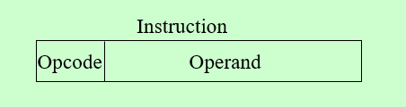
Implied addressing mode
Operand is specified implicitly in the definition of instruction
Example :
INCA
CRC
CLA
AMIT YADAV ACSBS 0303 COA Unit I

Slide 15
Immediate addressing mode
Operand is directly provided as constant.
Operand is part of instruction
No computation is required to calculate EA.
Example : ADD 5
  Add 5 to contents of accumulator
  5 is operand
AMIT YADAV ACSBS 0303 COA Unit I

Slide 16
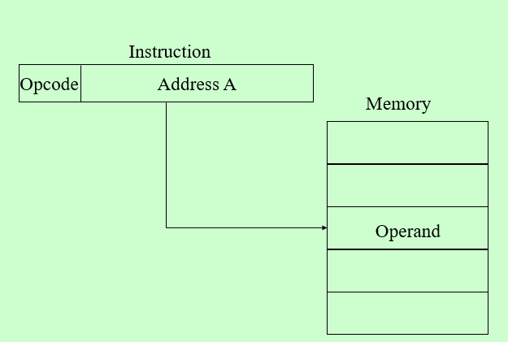
Direct addressing mode(absolute AM)
Actual address is given in the instruction
Use to access the variable
Example: ADD X
AC <--AC + M[X].
AMIT YADAV ACSBS 0303 COA Unit I

Slide 17
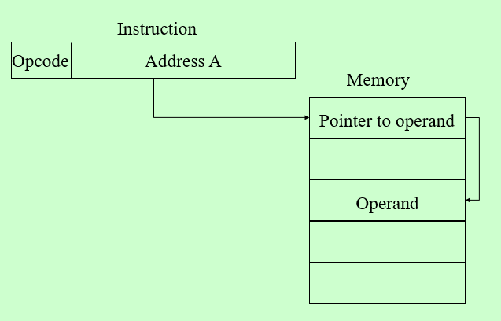
Indirect addressing mode
Used to implement pointer and passing parameter
2 memory access required
AMIT YADAV ACSBS 0303 COA Unit I

Slide 18
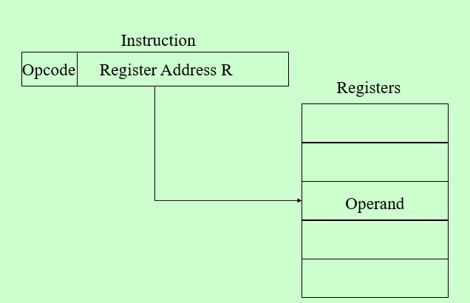
Register addressing mode
Operand is present in the register.
Register no. is written in instruction.
Operand is held in register named in address filed
EA = R
AMIT YADAV ACSBS 0303 COA Unit I

Slide 19
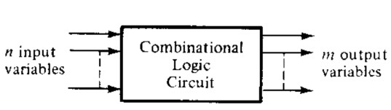
Combinational Logic Circuits
A combinational circuit consists of input variables (n), logic gates, and output variables (m).
For (n) input variables there are 2^{n} possible combinations of binary input values.
Each output function expressed in terms of the (n) input variables
Khyai Kandpal DSD (KEC-302) UNIT- 2

Slide 20

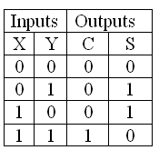
Half Adder
Half adder is a combinational arithmetic circuit that adds two numbers and produces a sum bit(S) and carry bit (C) as the ouput. If A and B are the input bits ,then sum bit(S) is the X-OR of A and B and the carry bit (C) will be the AND of A and B.
The block diagram of half adder is:
Truth Table for half adder is:
Khyai Kandpal DSD (KEC-302) UNIT- 2

Slide 21
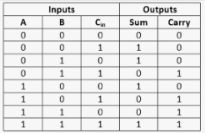
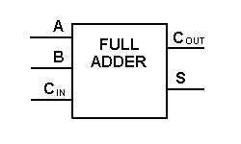
Full Adder
Full adder is developed to overcome the drawbacks of Half Adder circuit. It can add two one-bit numbers A and B, sum S and carry C.
The full adder is a three input and two output combinational circuit
Truth Table : Block Diagram:
Khyai Kandpal DSD (KEC-302) UNIT- 2

Slide 22
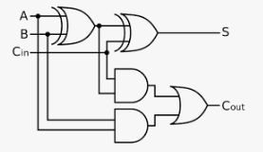
Full Adder
Circuit diagram of full adder
Sum = A XOR B XOR C_{in}
    Carry = AB + BC_{in} + C_{in} A=AB + C_{in} (A xor B)
Khyai Kandpal DSD (KEC-302) UNIT- 2

Slide 23
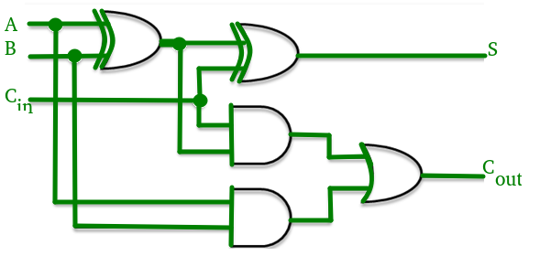
Carry Look ahead adder
A carry-look ahead adder (CLA) or fast adder is a type of electronic adder used in digital logic. A carry-look ahead adder improves speed by reducing the amount of time required to determine carry bits.
A carry look-ahead adder reduces the propagation delay by introducing more complex hardware. In this design, the ripple carry design is suitably transformed such that the carry logic over fixed groups of bits of the adder is reduced to two-level logic.
AMIT YADAV COA Unit 2

Slide 24
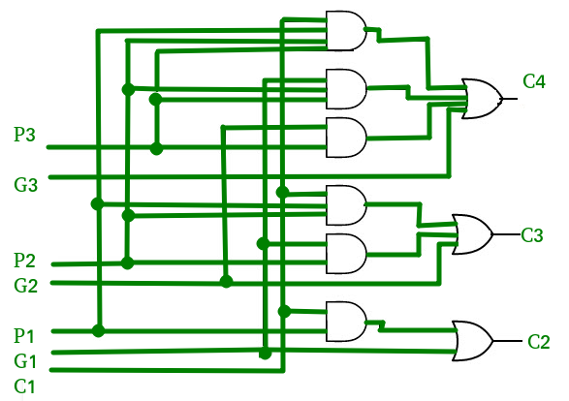
Carry Look ahead adder
The implementation of three Boolean functions for each carry output (C2,C3 and C4 ) for a carry look-ahead carry generator shown in diagram below figure.
Advantages –
The propagation delay is reduced.
It provides the fastest addition logic.
Disadvantages –
The Carry Look-ahead adder circuit gets complicated as the number of variables increase.
The circuit is costlier as it involves more number of hardware.
AMIT YADAV COA Unit 2

Slide 25
Carry look-ahead adder
This adder is used to eliminate the carry propagation delay problem in binary adder .
In binary adder ,each stage depends upon the carry generated by previous stage.It creates lots of delays. When we want to add two large binary no.
One widely used approach employs the principle of carry look-ahead solves this problem by calculating the carry signals in advance, based on the input signals.
This type of adder circuit is called as carry look-ahead adder (CLA adder). It is based on the fact that a carry signal will be generated in two cases:
when both bits A_{i} and B_{i} are 1, or
when one of the two bits is 1 and the carry-in (carry of the previous stage) is 1.
AMIT YADAV COA Unit 2

Slide 26
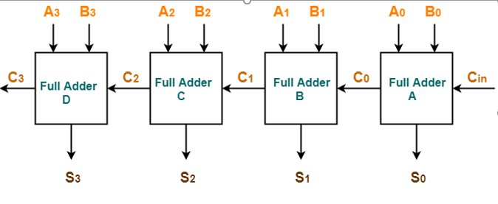

RIPPLE CARRY ADDER
AMIT YADAV COA Unit 2

Slide 27
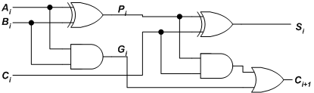
Carry look-ahead adder
The Figure shows the full adder circuit used to add the operand bits in the i^{th} column; namely A_{i} & B_{i} and the carry bit coming from the previous column (C_{i} ).
AMIT YADAV COA Unit 2

Slide 28
Carry look-ahead adder
G_{i} is known as the carry Generate signal since a carry (C_{i+1}) is generated whenever G_{i} =1, regardless of the input carry (C_{i}).
In this circuit, the 2 internal signals P_{i} and G_{i} are given by:
Pi = Ai ⊕ Bi ………………………(1)
G_{i}
= Ai Bi ……………….……..(2)
The output sum and carry can be defined as :
Si = Pi ⊕ Ci ……………………(3)
^{C}i +1 ^{= G}i
+ Pi Ci ………….(4)
AMIT YADAV COA Unit 2

Slide 29
Carry look-ahead adder
The Boolean expression of the carry outputs of various stages can be written as follows:
C₁ = G₀ + P₀C₀
C₂ = G₁ + P₁C₁ = G₁ + P₁ (G₀ + P₀C₀)
= G₁ + P₁G₀ + P₁P₀C₀
C₃ = G₂ + P₂C₂ = G₂ + P₂G₁ + P₂P₁G₀ + P₂P₁P₀C₀ C₄ = G₃ + P₃C₃
= G₃ + P₃G₂ + P₃P₂G₁ + P₃P₂P₁G₀ + P₃P₂P₁P₀C₀
AMIT YADAV COA Unit 2

Slide 30
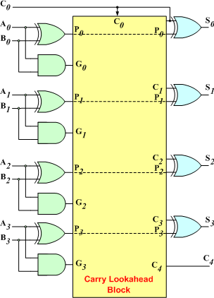
Carry look-ahead adder
The 4-bit carry look-ahead (CLA) adder consists of 3 levels of logic:
AMIT YADAV COA Unit 2

Slide 31
IEEE Standard for Floating Point Numbers
The IEEE Standard for Floating-Point Arithmetic (IEEE 754) is a technical standard for floating-point computation which was established in 1985 by the Institute of Electrical and Electronics Engineers (IEEE).
IEEE 754 has 3 basic components:
The Sign of Mantissa –
0 represents a positive number while 1 represents a negative number.
The Biased exponent –
A bias is added to the actual exponent in order to get the stored exponent.
The Normalized Mantissa –
A normalized mantissa is one with only one 1 to the left of the decimal.
AMIT YADAV COA Unit 2

Slide 32
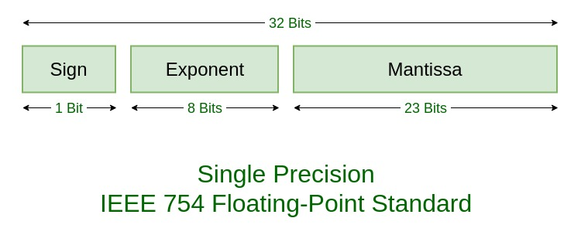
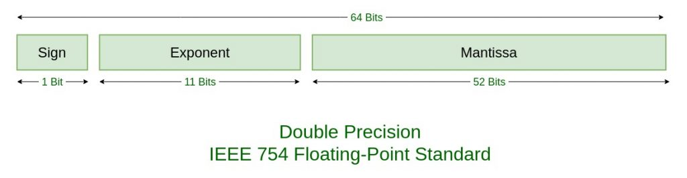
IEEE Standard for Floating Point Numbers
IEEE 754 numbers are divided into two based on the above three components: single precision and double precision.
AMIT YADAV COA Unit 2

Slide 33
Floating point arithmetic operation
FLOATING POINT Multiplication
The multiplication of two floating-point numbers requires that we multiply the mantissas and add the exponents. The multiplication of the mantissas is performed in the same way as in fixed-point to provide a double-precision.
The multiplication algorithm can be subdivided into four parts:
Check for zeros.
Add the exponents.
Multiply the mantissas.
Normalize the product.
AMIT YADAV COA Unit 2

Slide 34
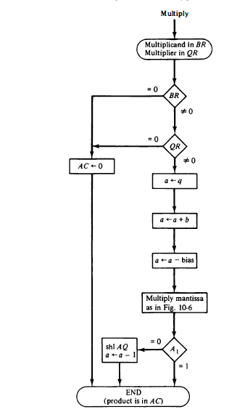
FLOATING POINT Multiplication
Flow diagram
AMIT YADAV COA Unit 2

Slide 35
Topic Objective & Mapping
Topic | Topic Objective | Course outcome
Multiplier | To understand the basic concepts of Multiplier. | CO2
AMIT YADAV COA Unit 2

Slide 36
Multiplier
A basic multiplier can consist of three parts:
• Partial product generation
• Partial product addition and
• Final addition
Several types of multipliers are studied: array multipliers, wallace tree multipliers, booth multiplier.
AMIT YADAV COA Unit 2

Slide 37
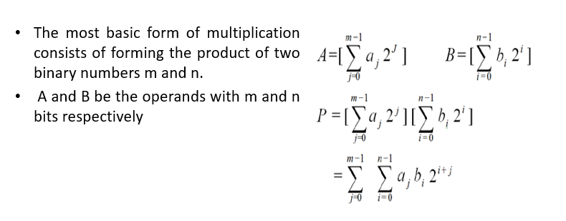
Basic Multiplication Operation
AMIT YADAV COA Unit 2

Slide 38
Array Multiplier
Array multiplier is common in multiplier design due to its regular and compact structure.
The structure of array multiplier is organized by several stages of adders and AND-gates.
It generates all the partial products after only one AND-gate delay. Then, it sums up all partial products sequentially.
AMIT YADAV COA Unit 2

Slide 39
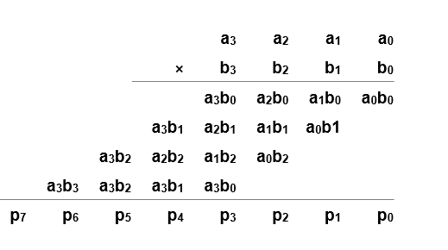
Array Multiplier
4*4 bit multiplication
AMIT YADAV COA Unit 2

Slide 40
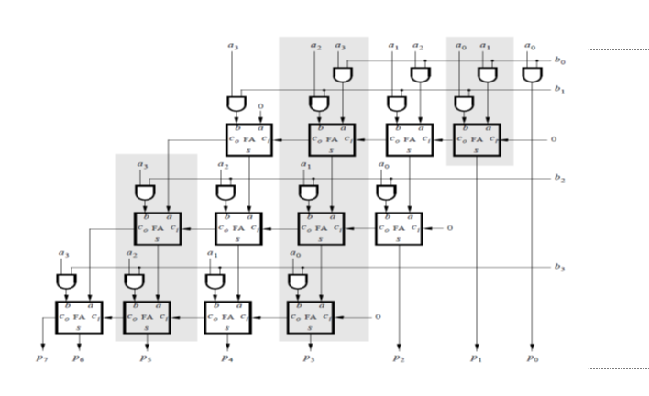
Array Multiplier
AMIT YADAV COA Unit 2

Slide 41
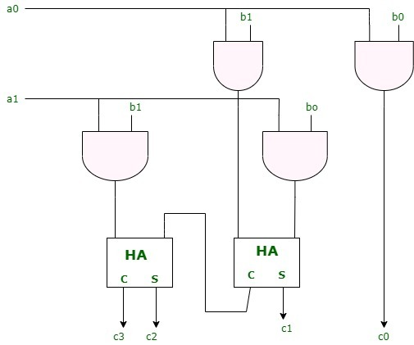
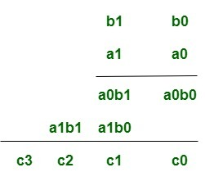
Array Multiplier
An array multiplier is a digital combinational circuit used for multiplying two binary numbers by employing an array of full adders and half adders.
This array is used for the nearly simultaneous addition of the various product terms involved.
The multiplication of two 2-bit numbers as shown in figure. The multiplicand bits are b1 and b0, the multiplier bits are a1 and a0, and the product is -
AMIT YADAV COA Unit 2

Slide 42
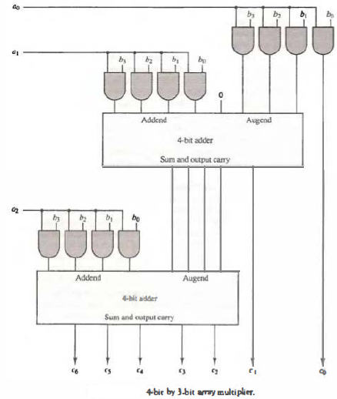
Array Multiplier
4 bit Array multiplier B=b3 b2 b1 b0 and A= a2 a1 a0.
For j multipliers &
k multiplicands bits ,
we needs
j x k AND gates
(j-1 )x k bit adders
produce
A product of j + k bits
AMIT YADAV COA Unit 2

Slide 43
Booth Multiplier
Traditional hardware multiplication is performed in the same way multiplication is done by hand: partial products are computed, shifted appropriately, and summed.
This algorithm can be slow if there are many partial products (i.e. many bits) because the output must wait until each sum is performed. Booth’s algorithm cuts the number of required partial products in half.
This increases the speed by reducing the total number of partial product sums that must take place.
AMIT YADAV COA Unit 2

Slide 44
Booth Multiplier
Bits Operation Performed:
00 no arithmetic operation
01 add multiplicand to left half of product
10 subtract multiplicand from left half of product
11 no arithmetic operation
AMIT YADAV COA Unit 2

Slide 45
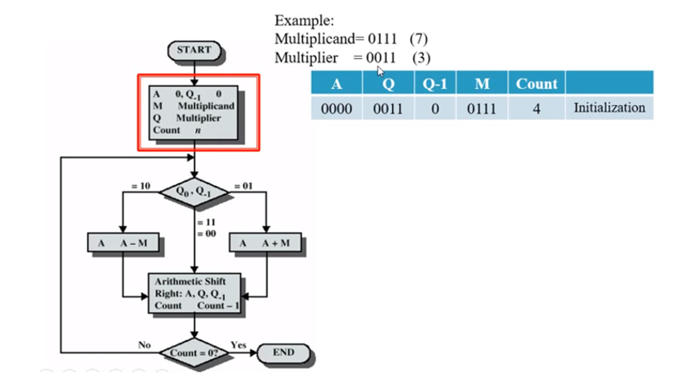
Booth Multiplier
AMIT YADAV COA Unit 2

Slide 46
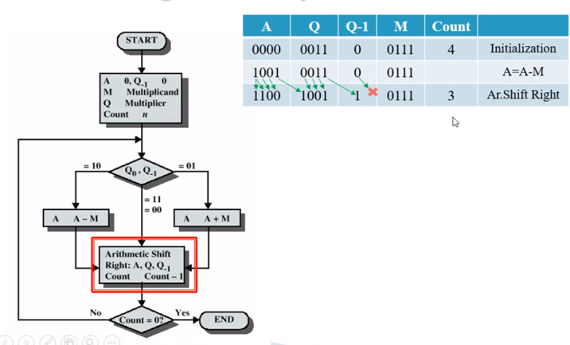
Booth Multiplier
AMIT YADAV COA Unit 2

Slide 47
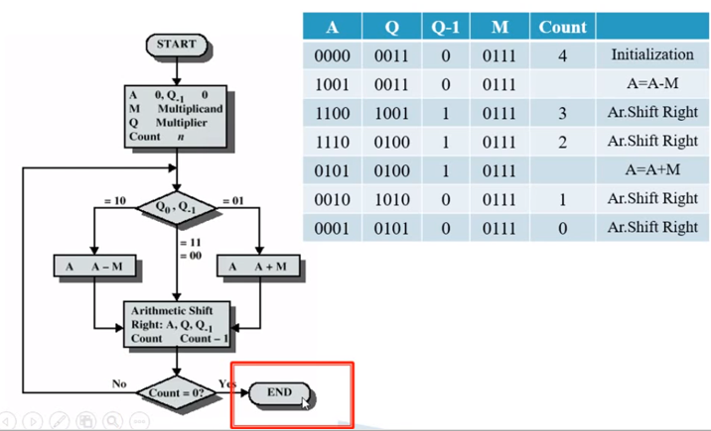
Booth Multiplier
AMIT YADAV COA Unit 2

Slide 48
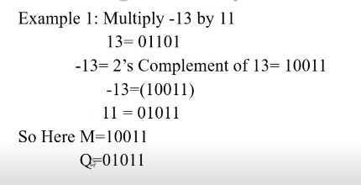
Booth Multiplier
AMIT YADAV COA Unit 2

Slide 49
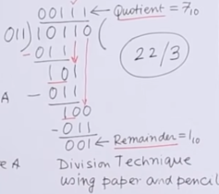
Division and logic operations
Division
Division of two fixed-point binary numbers in signed magnitude representation is performed with paper and pencil by a process of successive compare, shift and subtract operations.
Binary division is much simpler than decimal division because here the quotient digits are either 0 or 1 and there is no need to estimate how many times the dividend or partial remainder fits into the divisor. .
AMIT YADAV COA Unit 2

Slide 50
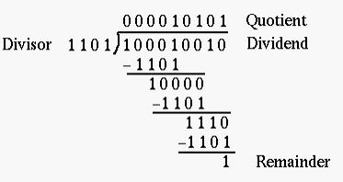
Division and logic operations
Division
.
AMIT YADAV COA Unit 2

Slide 51
Divide Overflow
Divide Overflow condition occurs when :
The no. of bits in dividend is twice as the no bits in the divisor.
The higher order half bits of the dividend has value more than or equal to the value of the total bits of the divisor
The divide overflow also check that whether the divisor is zero or not.
AMIT YADAV COA Unit 2

Slide 52
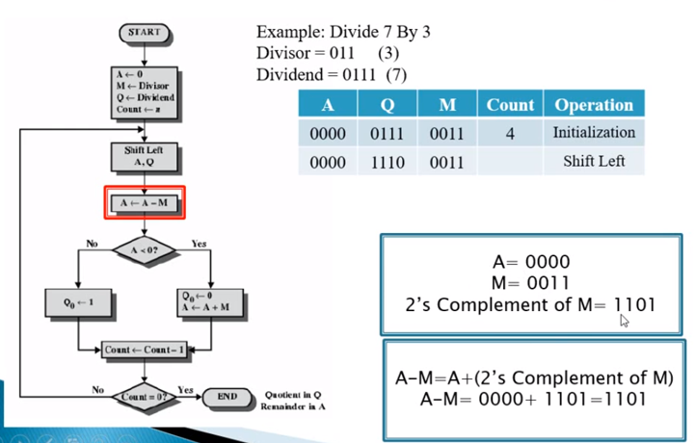
Restoring Division Algorithm
AMIT YADAV COA Unit 2

Slide 53
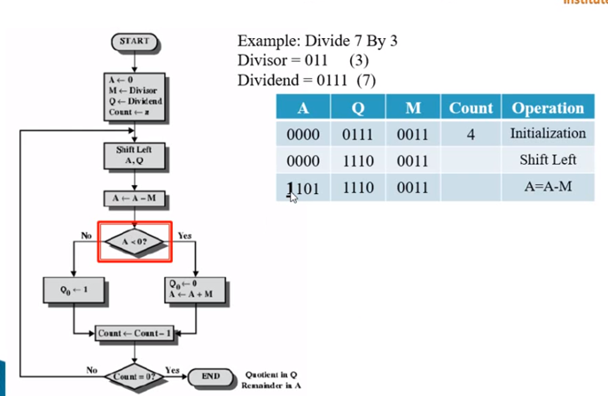
Restoring Division Algorithm
AMIT YADAV COA Unit 2

Slide 54
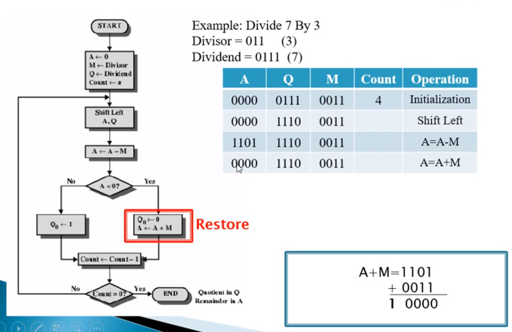
Restoring Division Algorithm
AMIT YADAV COA Unit 2

Slide 55
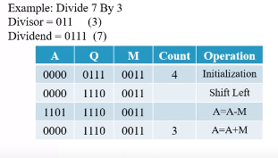
Restoring Division Algorithm
AMIT YADAV COA Unit 2

Slide 56
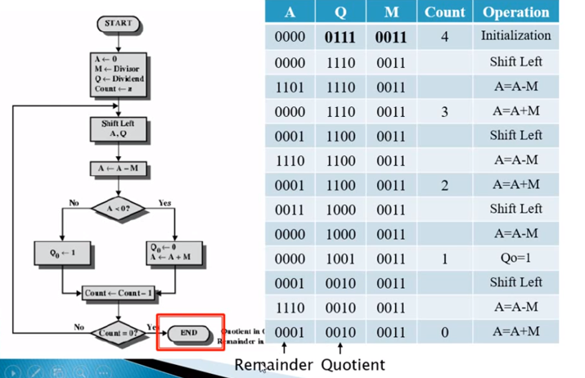
Restoring Division Algorithm
AMIT YADAV COA Unit 2

Slide 57
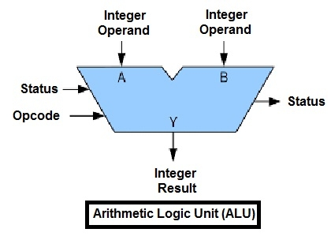
Arithmetic & logic unit design
Inside a computer, there is an Arithmetic Logic Unit (ALU), which is capable of performing logical operations (e.g. AND, OR, Ex-OR, Invert etc.)
In addition to the arithmetic operations (e.g. Addition, Subtraction etc.).
The control unit supplies the data required by the ALU from memory, or from input devices, and directs the ALU to perform a specific operation based on the instruction fetched from the memory. ALU is the “calculator” portion of the computer.
Different operation as carried out by ALU can be categorized as follows
Logical operations
Bit-Shifting Operations
Arithmetic operations
AMIT YADAV COA Unit 2

Slide 58
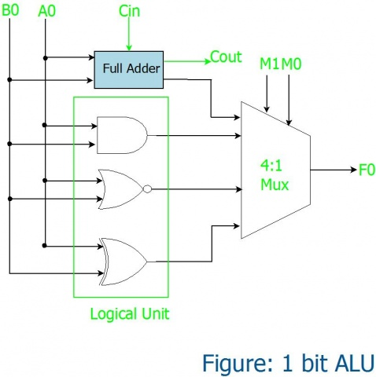
Arithmetic & logic unit design
1-bit ALU Design
Inputs |  | Outputs
M1 | M0 | Operation
0 | 0 | SUM
1 | 0 | AND
0 | 1 | OR
1 | 1 | XOR
AMIT YADAV COA Unit 2

Slide 59
Weekly Assignment
Define Half adder.
Define Full adder.
Explain Array Multiplier.
Why Booth algorithm is important for multiplication ?
Explain the signed magnitude algorithm.
Explain the Advantages and Disadvantages of CLA.
How hardware diagram of booth algorithm differ from signed magnitude algorithm ?
Calculate the No. of AND gates, Adders, Product if J multiplier bits and K multiplicands. Explain with suitable example.
Explain the IEEE 754 floating point representation for floating point numbers with examples.
Write down the short notes on ALU in computer.
AMIT YADAV COA Unit 2

Slide 60
Weekly Assignment
1. Design array multiplier for b1 b0 X a1 a0 and b3 b2 b1 b0 X a2 a1 a0 and also write down the formula for no. of AND gate calculations.
2. Show the contents of registers E, A, Q and SC during the process of division 00001111 by 0011.
3. Show the hardware diagram & flow chart of Booth algorithm for multiplying two numbers.
4. Demonstrate the Cary Look Ahead adder with suitable diagram and advantages .
5. Define IEEE 754 standard for floating point representation with suitable example.
(23.175)₁₀ b) (0.6128)₁₀ c) (1000.010101)₂
AMIT YADAV COA Unit 2

Slide 61
Topic Links
You tube/other Video Links
https://www.youtube.com/watch?v=vcvgvqnH7GA
https://www.youtube.com/watch?v=U62iP8RkZIk
https://www.youtube.com/watch?v=6ToR6vuRb3M
https://www.youtube.com/watch?v=9nkCLdhLDZk
https://www.youtube.com/watch?v=0HiGruw9VcQ
AMIT YADAV COA Unit 2

Slide 62
MCQ
1. The ‘heart’ of the processor which performs many different operations .
a) Arithmetic and logic unit b) Motherboard c) Control Unit d) Memory
2. Which of the following is not a bitwise operator?
a) | b) ^ c) . d) <<
3. The sign magnitude representation of -1 is __________
a) 0001 b) 1110 c) 1000 d) 1001
4. IEEE stands for ___________
5. The ALU gives the output of the operations and the output is stored in the ________
a) Memory Devices b) Registers c) Flags d) Output Unit
6 The IEEE standard followed by almost all the computers for floating point arithmetic
a) IEEE 260 b) IEEE 488 c) IEEE 754 d) IEEE 610
7. Which of the following is often called the double precision format?
a) 64-bit b) 8-bit c) 32-bit d) 128-bit
Solution 1 a. 2c. 3 d. 4 Institute of Electrical and electronics engineers. 5 b 6 c 7a
AMIT YADAV COA Unit 2

Slide 63
Glossary Quizzes
Glossary ( Hazard,Both Stalls and Bubbles,Control hazard,Branch penalty)
Any condition that causes a processor to stall is called as _________
The periods of time when the unit is idle is called as ________
The stalling of the processor due to the unavailability of the instructions is called as ___________
The time lost due to the branch instruction is often referred to as ____________
Glossary ( Page frame,Page table base register,Processor and RAM,contiguous)
The area in the main memory that can hold one page is called as ___________
The starting address of the page table is stored in __________
The cache bridges the speed gap between ______ and __________
The memory allocated to each page is ……………....
AMIT YADAV COA Unit 2

Slide 64
Glossary Quizzes
Glossary ( Interface circuits,cell, 16,777,216,MMU)
______ serves as an intermediary between the device and the BUSes.
The smallest entity of memory is called _______
An 24 bit address generates an address space of ______ locations.
To get the physical address from the logical address generated by CPU we use ____________
Glossary (Registers, Frames,Valid bit,Register file)
During the transfer of data between the processor and memory we use ______
Physical memory is divided into sets of finite size called as ______
The _______ bit is used to indicate the validity of the page.
The general purpose registers are combined into a block called as ______
AMIT YADAV COA Unit 2

Slide 65
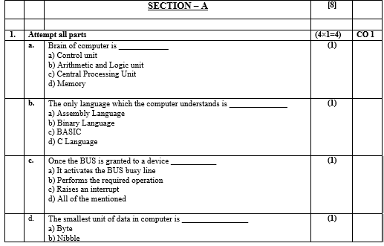
Old Question Papers
AMIT YADAV COA Unit 2

Slide 66
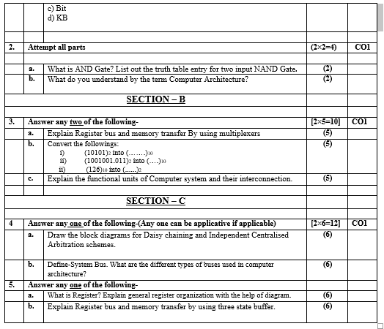
Old Question Papers
AMIT YADAV COA Unit 2

Slide 67
Expected Questions for University Exam
Explain CLA and design 4bit CLA consists of 3 level of logic.
Draw the flow chart for multiplying algorithm of sign magnitude data.
Show the contents of registers E, A, Q & SC during the process of division of 10100011 by 1011
Explain the IEEE 754 for floating point no. with examples
Show the flow diagram & multiplication process using Booth’s Algorithm for (-4) X (+3)
AMIT YADAV COA Unit 2

Slide 68
RECAP OF UNIT
In previous slides we discuss in details
Carry Look ahead adder.
Multiplication: Signed operand multiplication,
Booths algorithm and array multiplier.
Division and logic operations.
Floating point arithmetic operation,
Arithmetic & logic unit design.
IEEE Standard for Floating Point Numbers
AMIT YADAV COA Unit 2

